Slide 1
Mining and Utilizing Dataset Relevancy from Oceanographic Dataset (MUDROD) Metadata, Usage Metrics, and User Feedback to Improve Data Discovery and Access
NASA AIST (NNX15AM85G)
Yongyao Jiang, Chaowei (Phil) Yang, Yun Li,
George Mason University
Edward M Armstrong, Thomas Huang, David Moroni,
Chris Finch, Lewis Mcgibbney, JPL, NASA
GeoSemantics Symposium, 2017

Slide 2
Background
Traditional search engines (Keyword-based matching)
User query: sea surface temperature
Final query: sea AND surface AND temperature
The real intent of user
“sea surface temperature” OR “sst” OR “ghrsst” OR …
Notes:
Ghrsst is a sst mission

Slide 3
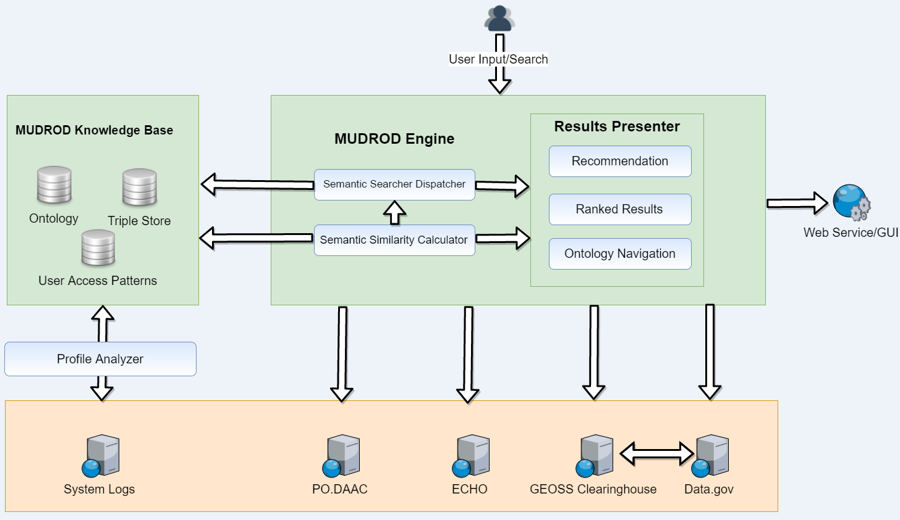
Objectives
Mine web logs to discover user access pattern
Build a knowledge base by combining user access pattern, existing ontology, and metadata
Improve data discovery by providing 1) better ranked results; 2) recommendation; 3) ontology navigation

Slide 4
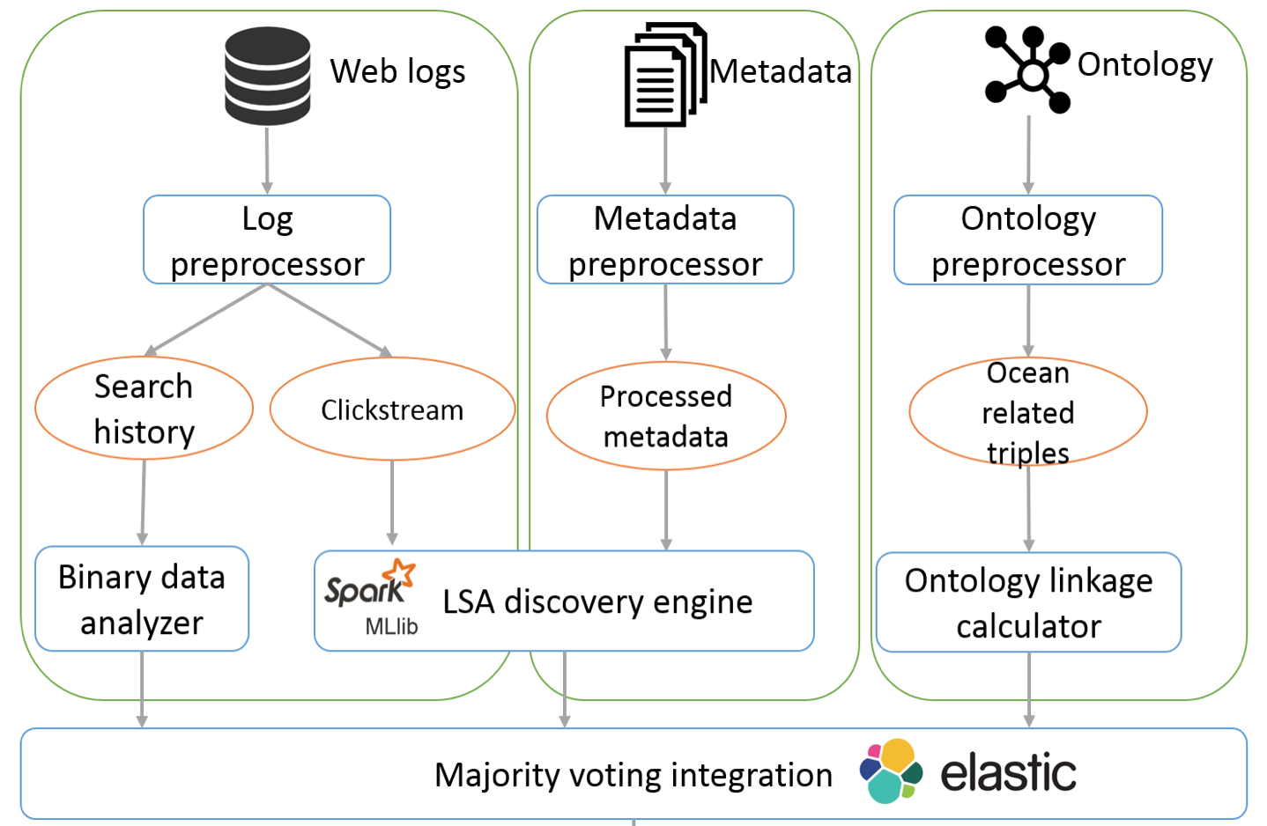
Semantic Research Workflow

Slide 5
Web logs
Requests sent from browser, recorded by server
Log files provided by PO.DAAC (HTTP, FTP)
68.180.228.99 - - [31/Jan/2015:23:59:13 -0800] "GET /datasetlist/... HTTP/1.1" 200 84779 "/ghrsst/" "Mozilla/5.0 ..."
Client IP: 68.180.228.99
Request date/time: [31/Jan/2015:23:59:13 -0800]
Request: " GET /datasetlist/... HTTP/1.1 "
HTTP Code: 200
Bytes returned: 84779
Referrer/previous page: “/ghrsst/"
User agent/browser: "Mozilla/5.0 ...
Notes:
Disrupt the train of thoughts

Slide 6

Data preparation
Web logs
User identification
Goal: reconstruct user browsing pattern (search history & clickstream) from a set of raw logs
Crawler detection
Session identification
Search history
Structure reconstruction
Clickstream
Additional steps include: word normalization, stop words removal, and stemming

Slide 7
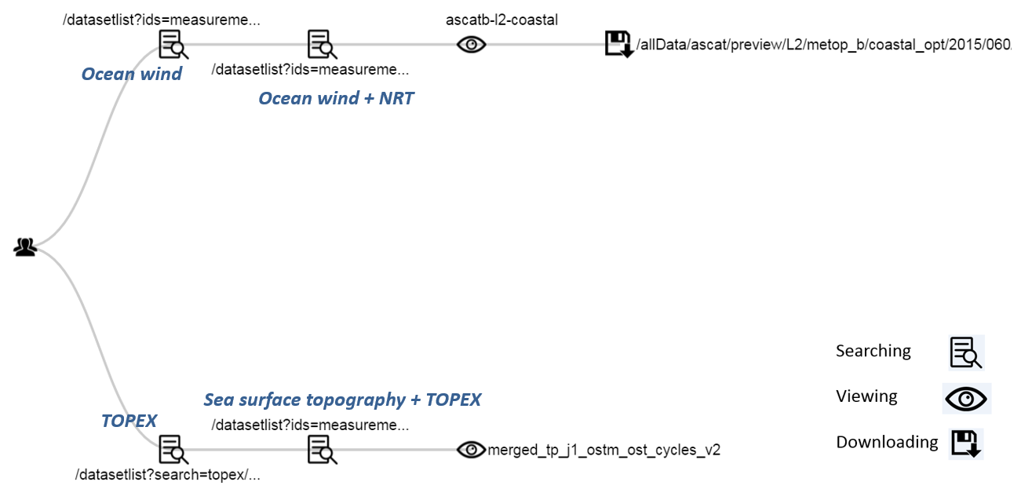
Reconstructed session structure
Notes:
Help find interesting user access patterns including those we didn’t realize

Slide 8
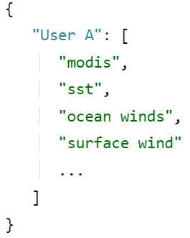
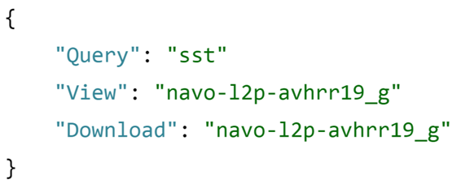
Data preparation results
1. User search history 2. Clickstream
Notes:
Clickstream means a series of mouse clicks while visiting a website

Slide 9
User search history
Hypothesis: the more frequent two queries co-occur in distinct users’ search history, the more similar they are.
ocean temperature,
ocean wind,
sea surface topography,
sea surface temperature, quikscat,
cross calibrate multi platform ocean surface wind vector analysis field,
grace,
aquarius project,
saline density
……
quikscat,
sea surface topography,
sea surface temperature, amsr,
oscar,
suomi npp,
altika,
dmsp f17
grace,
ocean temperature,
aquarius,
……
User A
User B

Slide 10
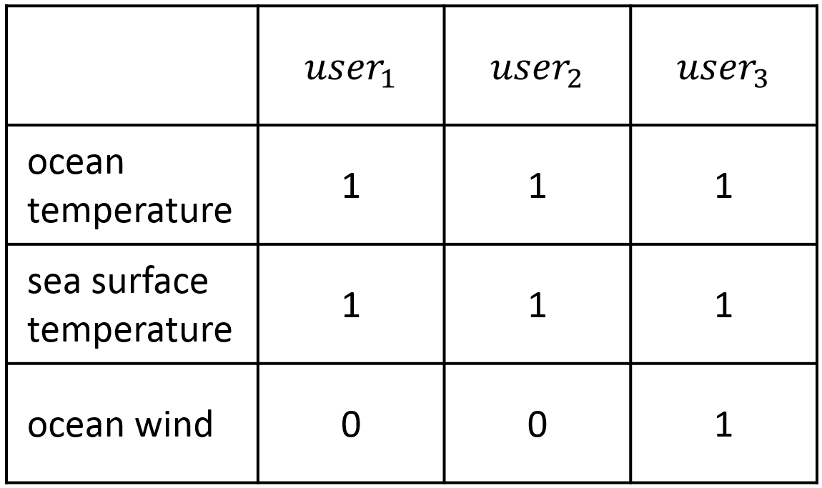
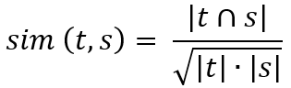
User search history
Create query – user matrix
Calculate binary cosine similarity (collaborative filtering)
Conceptual example
Notes:
Filter out rarely searched queries

Slide 11
Clickstream
Hypothesis: similar queries can result in similar clicking behavior
If two queries are similar, the data that get clicked after they are searched would be more likely to be similar
Similar?
Query b
Query a
Data
Notes:
Downloading has more weight than viewing

Slide 12
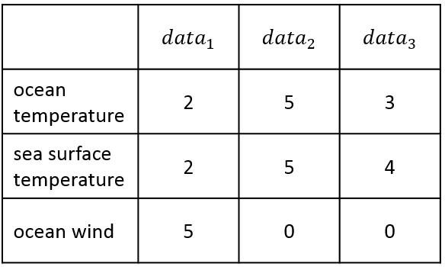
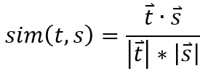
Clickstream
Create query – data matrix
Perform Latent Semantic analysis (LSA, feature normalization and reduction)
Calculate cosine similarity

Slide 13
Metadata
Hypothesis: semantically related terms tend to appear in the same metadata more frequently
Essentially the same as the clickstream analysis
Perform LSA over the term – metadata matrix
Similar?
Term b
Term a
Metadata
Notes:
All publicly available dataset metadata of PO.DAAC are harvested

Slide 14
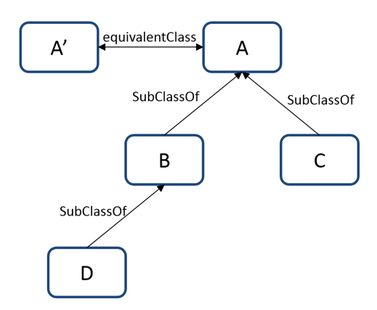
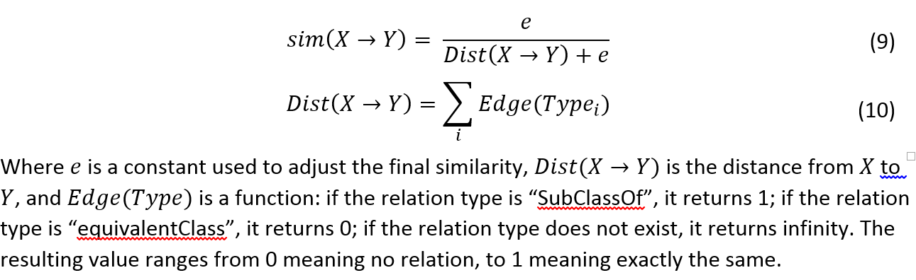
Existing ontology (SWEET)
SWEET (Raskin and Pan 2003)
Focus on only two relations
The closer, the more similar

Slide 15
Integration
All four results could be converted to
Problem:
None of them are perfect (uncertainty in data, hypothesis and method)
Metadata and ontology might have unknown terms to search engine end users
Sometimes, similarity values from different methods are inconsistent
Concept A
Similarity
Concept B

Slide 16
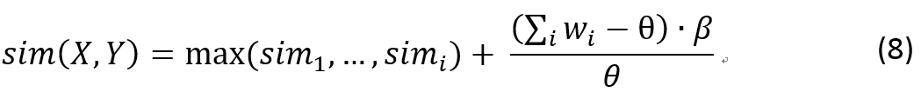
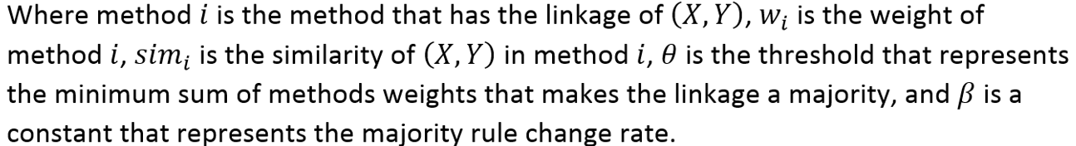
Integration
The maximum similarity of all of the components (large similarity appears to be more reliable)
The adjustment increment becomes larger when the similarity exists in more sources
Notes:
Given this methodology, the best from different methods is combined such that a strong relationships agreed upon by more of these four approaches would become stronger in the final list. Conversely, the results of different methods can be utilized to validate each other, as relationships that are only strong in a few methods have less strong relationships in the final list.

Slide 17
Results and evaluation
Query | Search history | Clickstream | Metadata | SWEET | Integrated list
ocean temperature | sea surface temperature(0.66), sea surface topography(0.56), ocean wind(0.56), aqua(0.49) | sea surface temperature(0.94), sst(0.94), group high resolution sea surface temperature dataset(0.89), ghrsst(0.87) | sst(0.96), ghrsst(0.77), sea surface temperature(0.72), surface temperature(0.63), reynolds(0.58) | None | sst(1.0), sea surface temperature(1.0), ghrsst(1.0), group high resolution sea surface temperature dataset(0.99), reynolds sea surface temperature(0.74)
Sample group | Overall accuracy
Most popular 10 queries | 88%
Least popular 10 queries | 61%
Randomly selected 10 queries | 83%
By domain experts

Slide 18
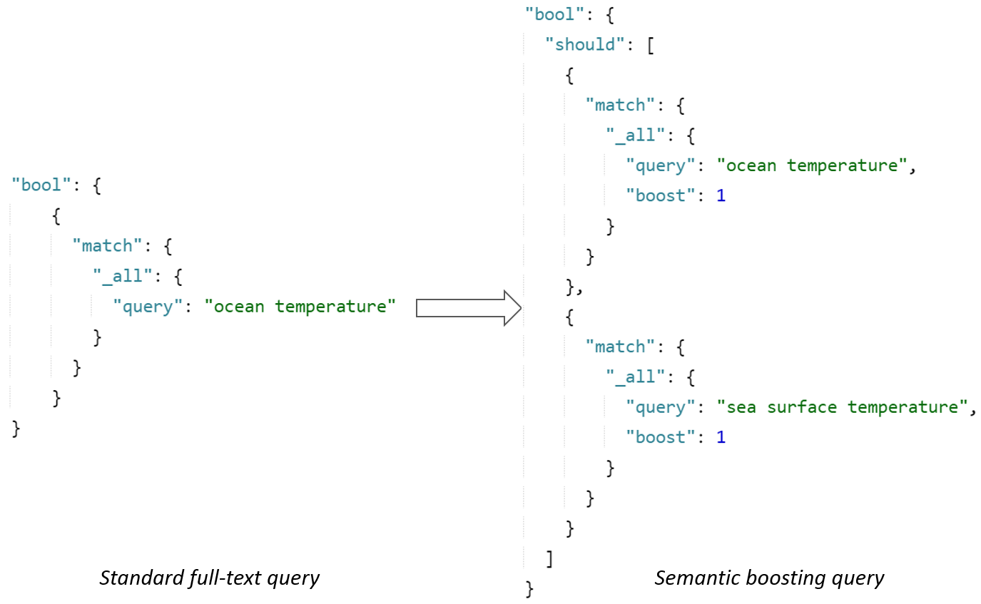
What can we use it for?
Query suggestion
Query modification

Slide 19
Conclusion
Can be used to discover domain-specific semantic relationships
Can be updated periodically as user behavior changes
Existing ontology is a just supplement, not a requirement
It is an automatic approach, and involves certain level of noise
The result is reasonable and more importantly saves huge amount of time from manually creating ontology

Slide 20
Resources
Part of the MUDROD project
Related papers
Jiang, Y., Y. Li, C. Yang, E. M. Armstrong, T. Huang & D. Moroni (2016) Reconstructing Sessions from Data Discovery and Access Logs to Build a Semantic Knowledge Base for Improving Data Discovery. ISPRS International Journal of Geo-Information, 5, 54.
Y. Li, Jiang, Y., C. Yang, K. Liu, E. M. Armstrong, T. Huang & D. Moroni (2016) Leverage cloud computing to improve data access log mining. IEEE Oceans 2016.
Jiang, Y., Y. Li, C. Yang, K. Liu, E. M. Armstrong, T. Huang & D. Moroni (2016) A Comprehensive Approach to Determining the Linkage Weights among Geospatial Vocabularies - An Example with Oceanographic Data Discovery. International Journal of Geographical Information Science (under review)
Jiang, Y., Y. Li, C. Yang, K. Liu, E. M. Armstrong, T. Huang, D. Moroni & L. Mcgibbney (2016) Towards intelligent geospatial discovery: a machine learning ranking framework. Remote Sensning (under review)
Available on GitHub: https://github.com/mudrod/mudrod

Slide 21
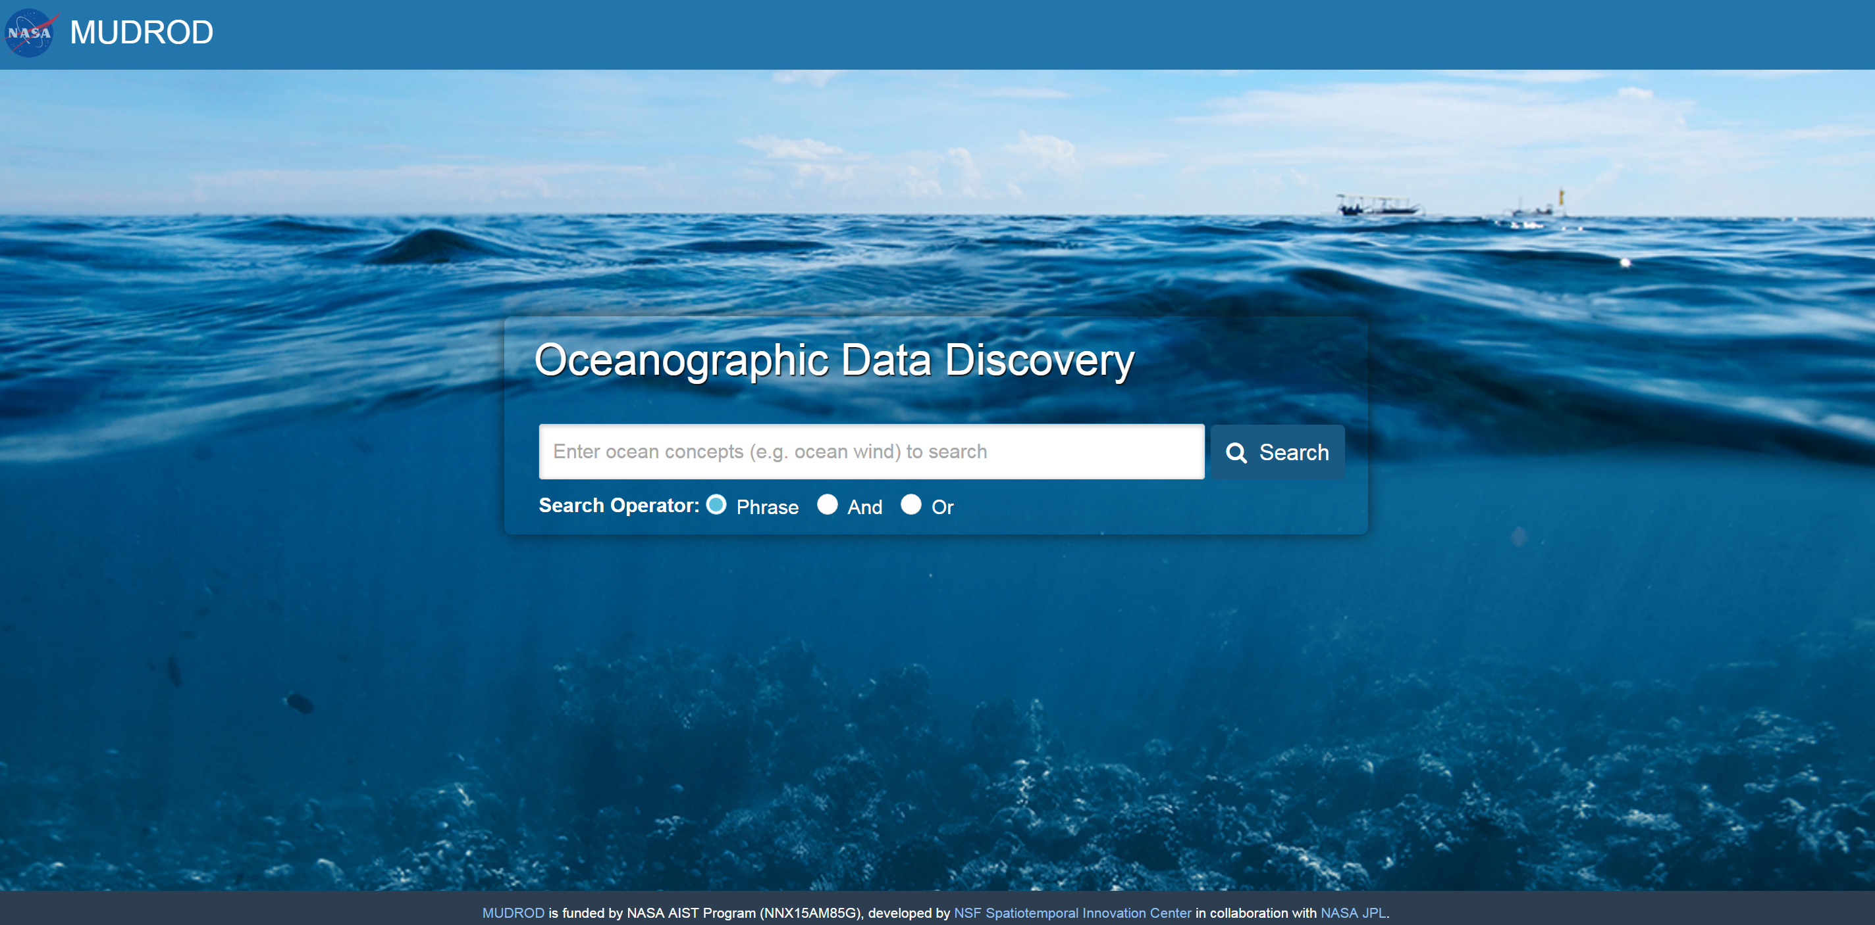
Demo
http://199.26.254.164:8080/mudrod-service/

